Slide 2
So how did you all do?
TIME FOR THE ANSWERS

Slide 3
Round 1:
How well do you know the nation’s favourite Christmas TV adverts?
THE ANSWERS

Slide 4
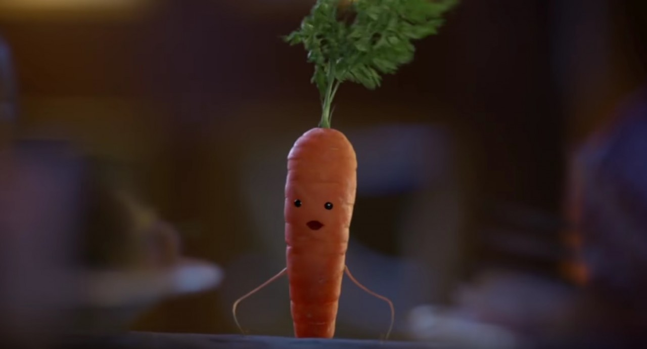
1.
Round 1:
How well do you know the nation’s favourite Christmas TV adverts?
These pictures are all from Christmas TV adverts, all you have to do is name the company that is being advertised.
Careful though, some companies feature more than once!!
ALDI

Slide 5
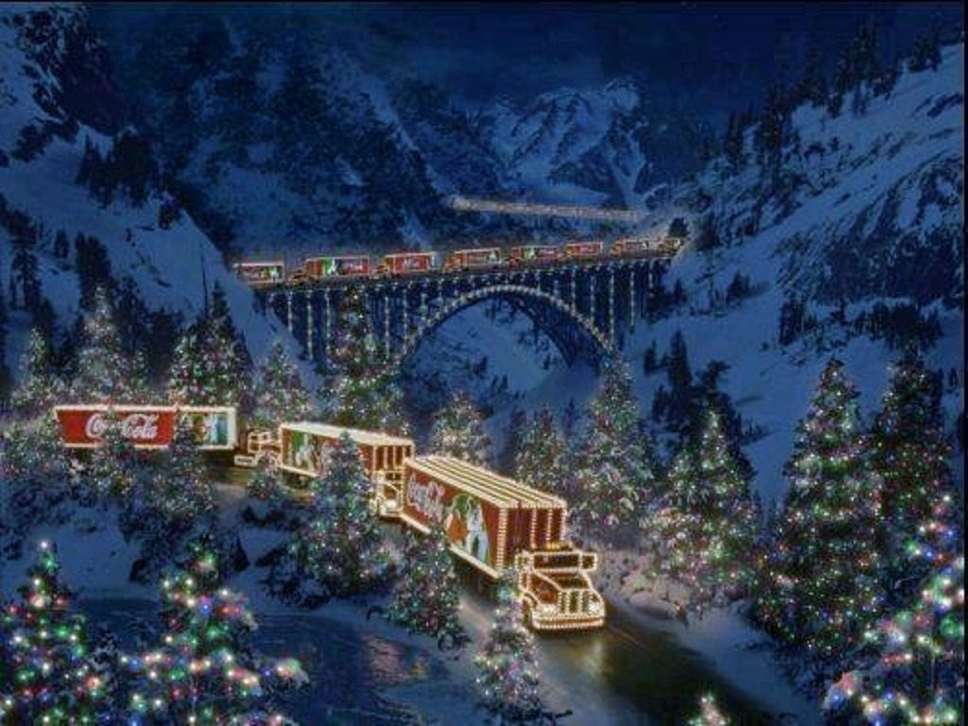
2.
Round 1:
How well do you know the nation’s favourite Christmas TV adverts?
These pictures are all from Christmas TV adverts, all you have to do is name the company that is being advertised.
Careful though, some companies feature more than once!!
COCA COLA

Slide 6
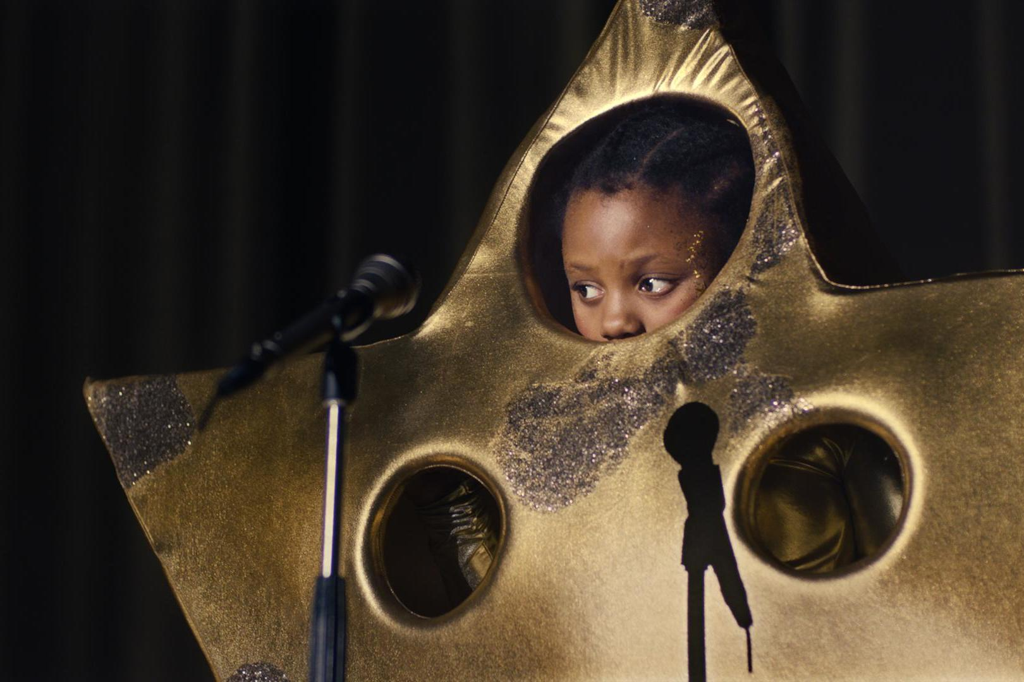
3.
Round 1:
How well do you know the nation’s favourite Christmas TV adverts?
These pictures are all from Christmas TV adverts, all you have to do is name the company that is being advertised.
Careful though, some companies feature more than once!!
SAINSBURYS

Slide 7
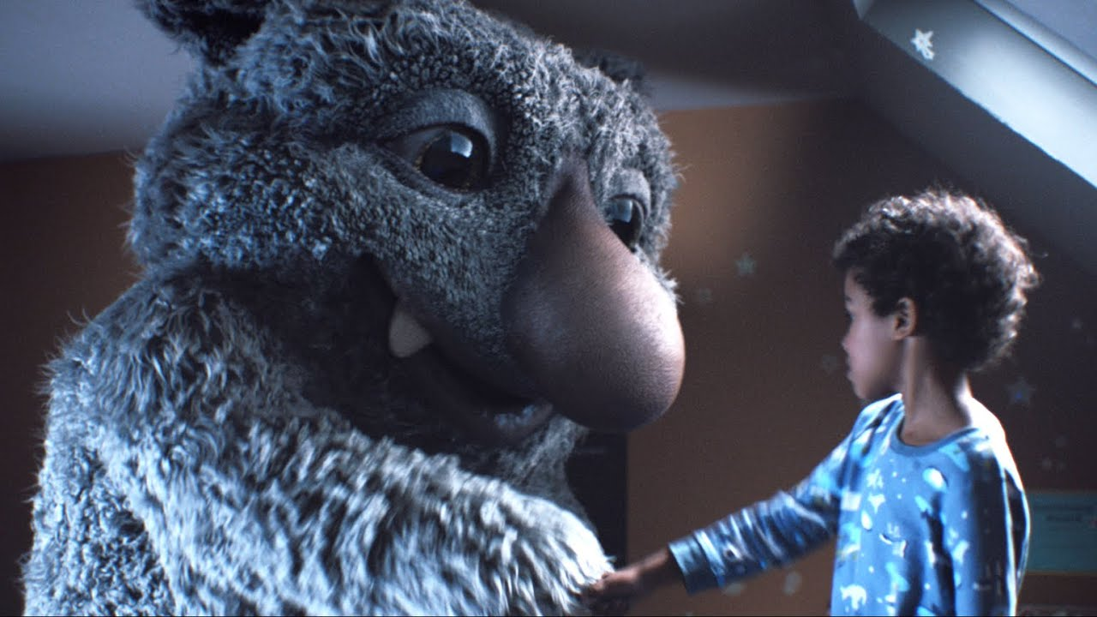
4.
Round 1:
How well do you know the nation’s favourite Christmas TV adverts?
These pictures are all from Christmas TV adverts, all you have to do is name the company that is being advertised.
Careful though, some companies feature more than once!!
JOHN LEWIS

Slide 8
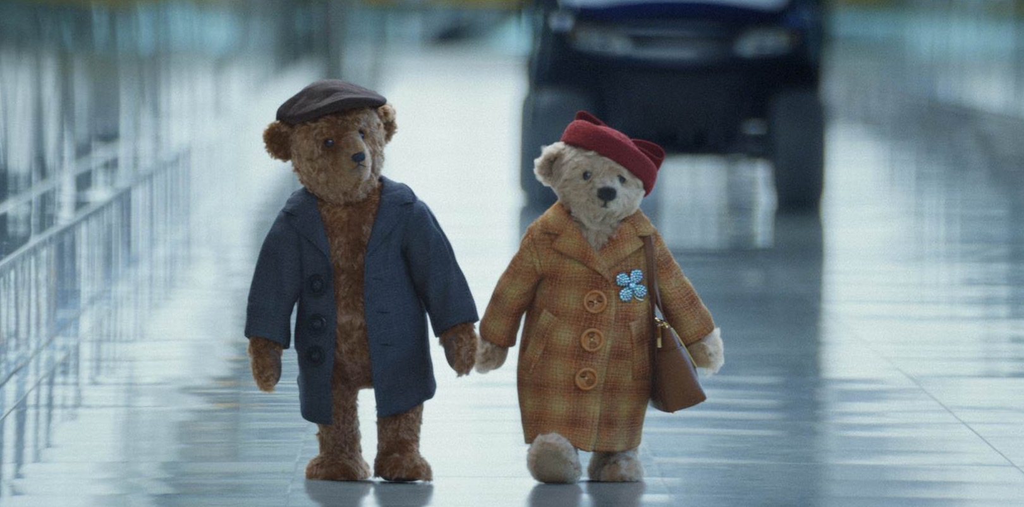
5.
Round 1:
How well do you know the nation’s favourite Christmas TV adverts?
These pictures are all from Christmas TV adverts, all you have to do is name the company that is being advertised.
Careful though, some companies feature more than once!!
HEATHROW AIRPORT

Slide 9
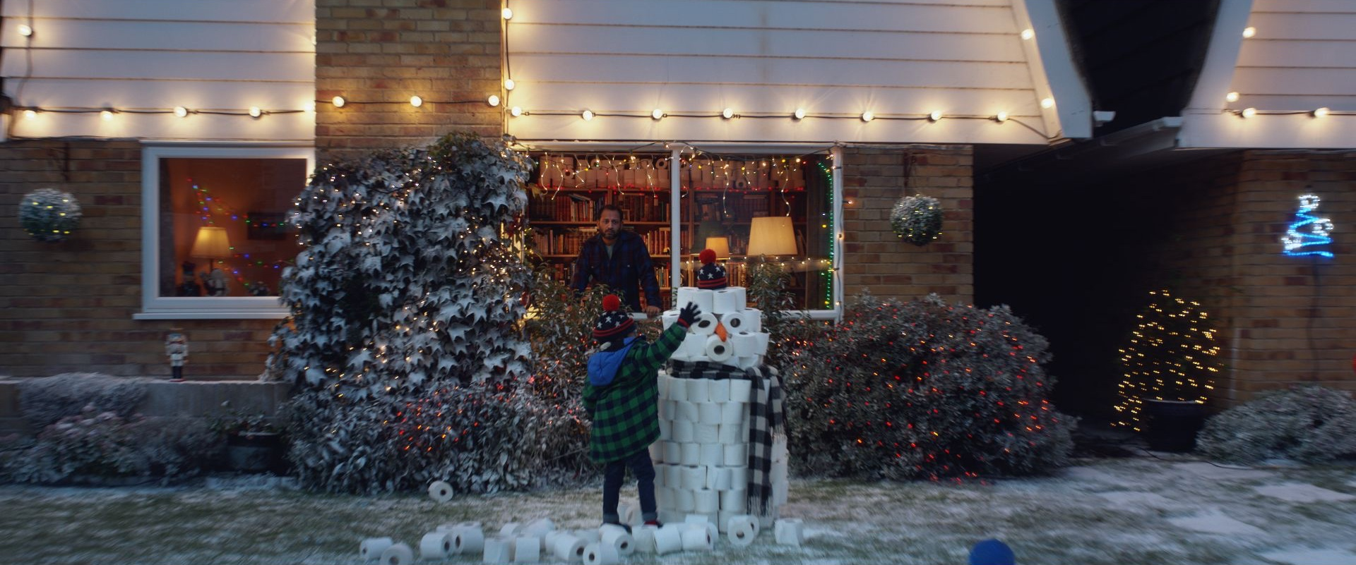
6.
Round 1:
How well do you know the nation’s favourite Christmas TV adverts?
These pictures are all from Christmas TV adverts, all you have to do is name the company that is being advertised.
Careful though, some companies feature more than once!!
TESCO

Slide 10
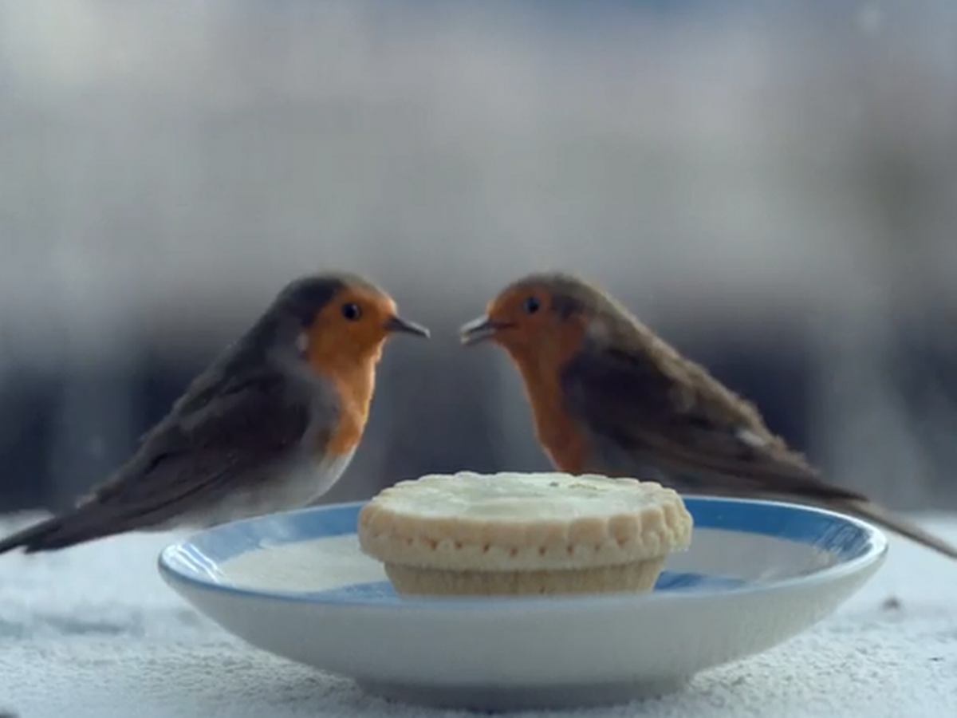
7.
WAITROSE

Slide 11
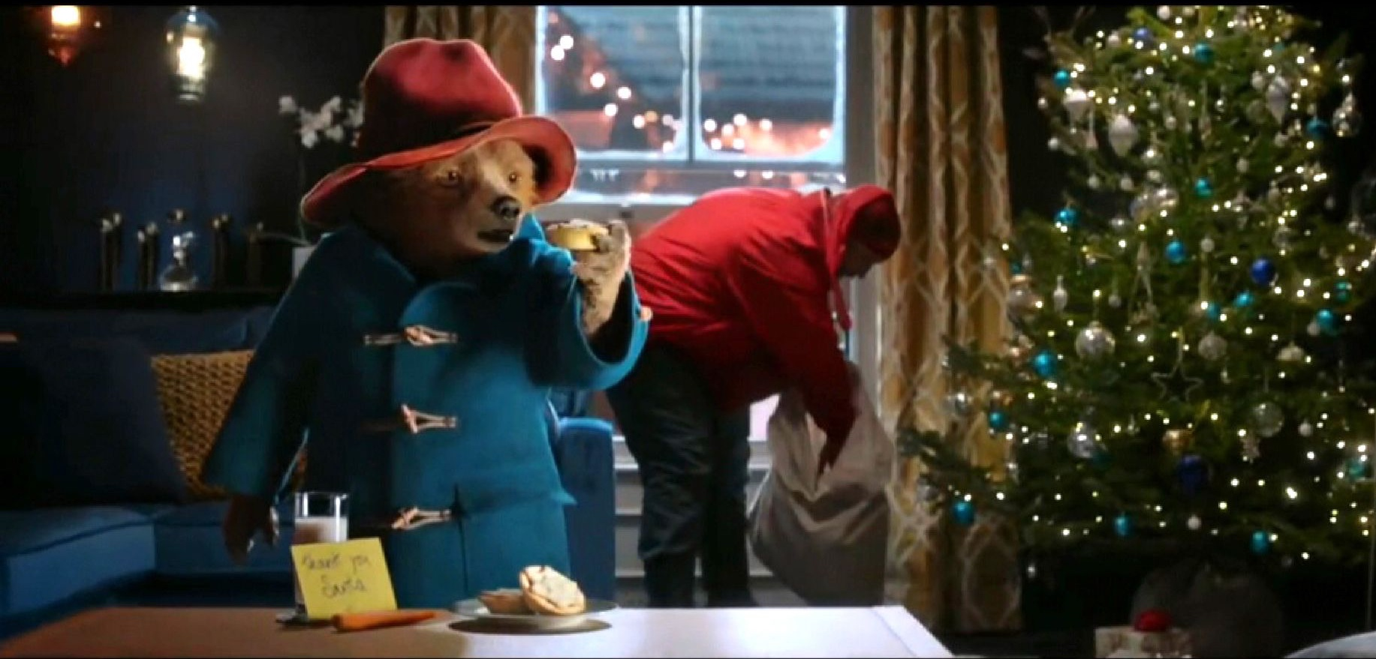
8.
MARKS & SPENCER

Slide 12
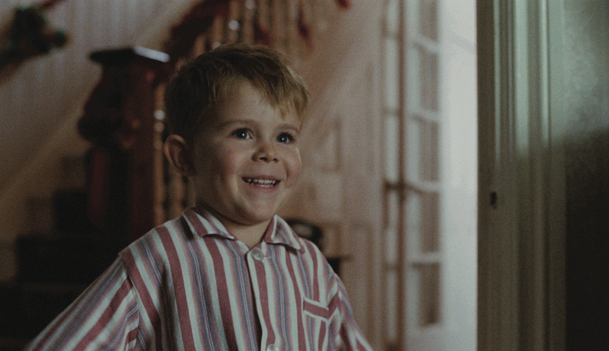
9.
JOHN LEWIS

Slide 13
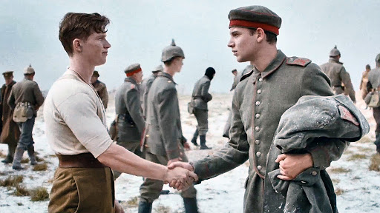
10.
SAINSBURYS

Slide 14
Round 2:
Food and Drink
THE ANSWERS

Slide 15
1.
What in Britain was traditionally mixed into a Christmas pudding "for good luck"?
COIN (In the UK the coin traditionally used was a silver 'six pence')

Slide 16
2.
Which alcohol is traditionally added to the base of a Christmas trifle?
SHERRY

Slide 17
3.
Which traditional Christmas treat is also used in Cockney rhyming slang?
MINCE PIES

Slide 18
Which type of sweet bread loaf, which originated in Milan, is traditionally eaten at Christmas in Italy and many other European countries?
4.
PANETTONE

Slide 19
5.
Which spoilsport made eating mince pies on Christmas day illegal in the 1650’s?
OLIVER CROMWELL

Slide 20
Which takeaway food is so popular in Japan at Christmas that it often must be ordered weeks in advance?
6.
KFC

Slide 21
7.
At a traditional Ukrainian Christmas dinner, how many courses would there be?
12 (One course for each of the 12 apostles)

Slide 22
Christmas presents have changed a lot throughout history! Which fruit was historically often found in children's stockings in the UK and considered a real luxury?
8.
ORANGES (They were considered to be a rare and exotic fruit until the 20th Century)

Slide 23
Visions of which sweet foodstuff danced in children’s heads as they slept, according to Clement Clarke Moore’s poem ‘Twas the Night Before Christmas’?
9.
SUGAR PLUMS

Slide 24
10.
Christstollen is a traditional Christmas fruit loaf of which country?
GERMANY

Slide 25
Round 3:
Find the Christmas link
THE ANSWERS

Slide 26
Name the largest cricket ground in England, which is the home ground of Middlesex County Cricket Club.
1.
LORD’S CRICKET GROUND

Slide 27
Take away my first letter, I’m a body part. Take away my last letter, I’m a legume. Take away my first and last letters, I’m a video game company. What am I?
2.
PEAR

Slide 28
When animals come together in groups they are sometimes given weird names. A group of what type of animal is called a gaggle?
3.
GEESE

Slide 29
4.
What do Harry Judd, Roger Taylor and John Bonham all have in common?
THEY ARE DRUMMERS

Slide 30
5.
Now you’ve worked out all the answer…
what is the link?
THE TWELVE DAYS OF CHRISTMAS

Slide 31
Round 4:
General Knowledge
THE ANSWERS

Slide 32
1.
What is the name of the fictional town in 'How the Grinch Stole Christmas'?
WHOVILLE

Slide 33
2.
Balsam, Douglas, Fraser and Noble are all types of what?
FIR TREES/CHRISTMAS TREES

Slide 34
3.
The Christmas Carol 'God Rest Ye Merry Gentlemen' brings tidings of what?
COMFORT AND JOY

Slide 35
4.
Which famous Christmas poem was written by Clement Clark Moore?
‘TWAS THE NIGHT BEFORE CHRISTMAS (originally called ‘A visit from St. Nicholas’)

Slide 36
5.
Which Christmas item was invented by Tom Smith in 1847?
CHRISTMAS CRACKER

Slide 37
If you add up all the gifts in the Christmas song 'The Twelve Days of Christmas', how many are there?
6.
364

Slide 38
‘'Driving Home for Christmas' was used in Christmas commercials for which supermarket chain in 1997, 1998, and 2011?
7.
ICELAND

Slide 39
8.
Which ocean is Christmas Island located in?
INDIAN OCEAN

Slide 40
Which British monarch was the first to broadcast a Christmas message from the sovereign to the British Empire?
9.
KING GEORGE V

Slide 41
In the 1947 Christmas comedy-drama Miracle on 34th Street, which actress plays the little girl brought up not to believe in Santa Claus?
10.
NATALIE WOOD

Slide 42
Round 5:
Name that Christmas movie
THE ANSWERS

Slide 43
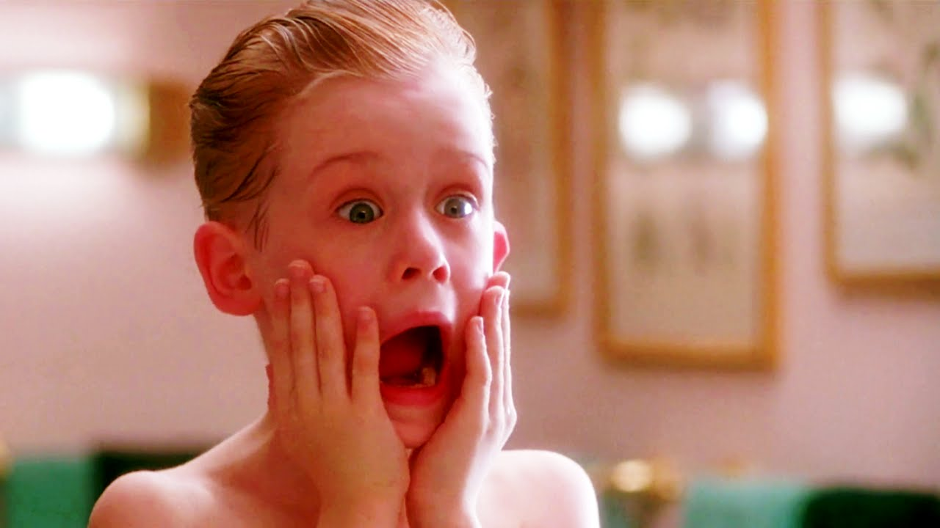
1.
HOME ALONE

Slide 44
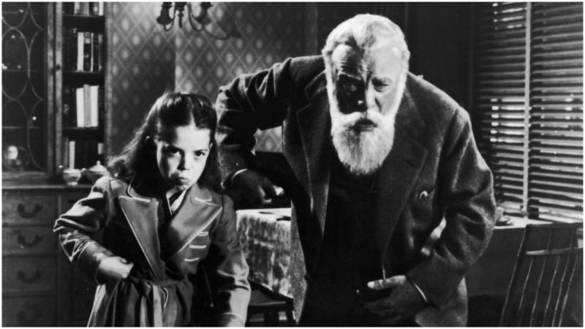
2.
MIRACLE ON 34TH STREET

Slide 45
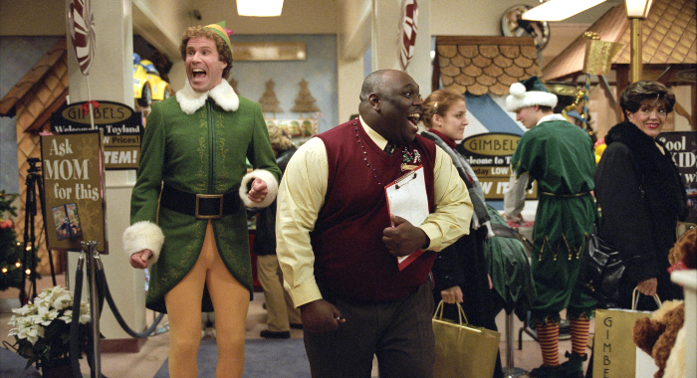
3.
ELF

Slide 46
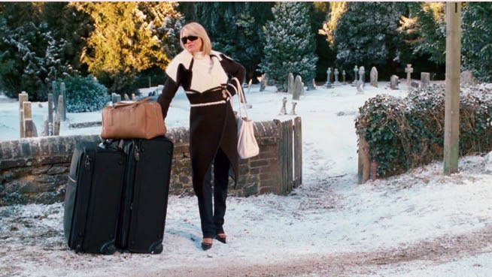
4.
THE HOLIDAY

Slide 47
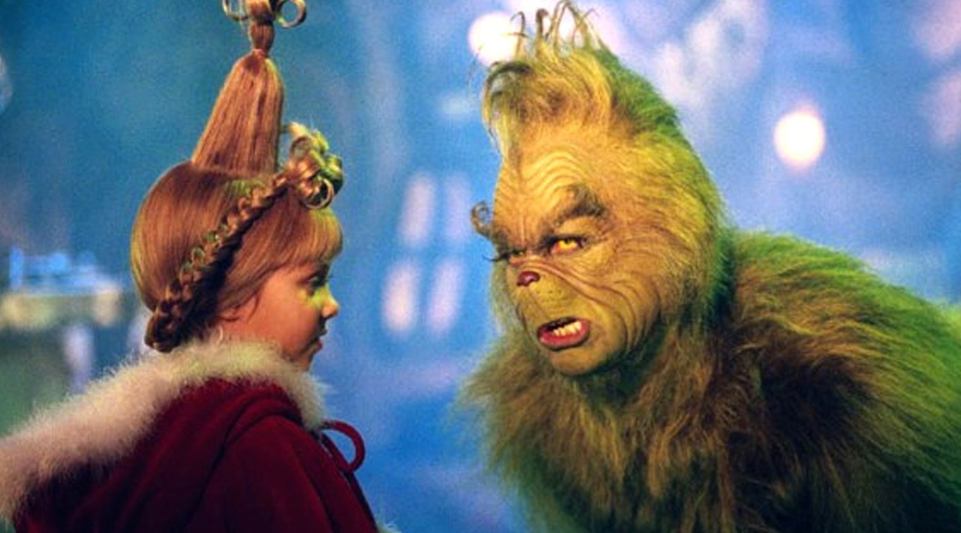
5.
THE GRINCH

Slide 48
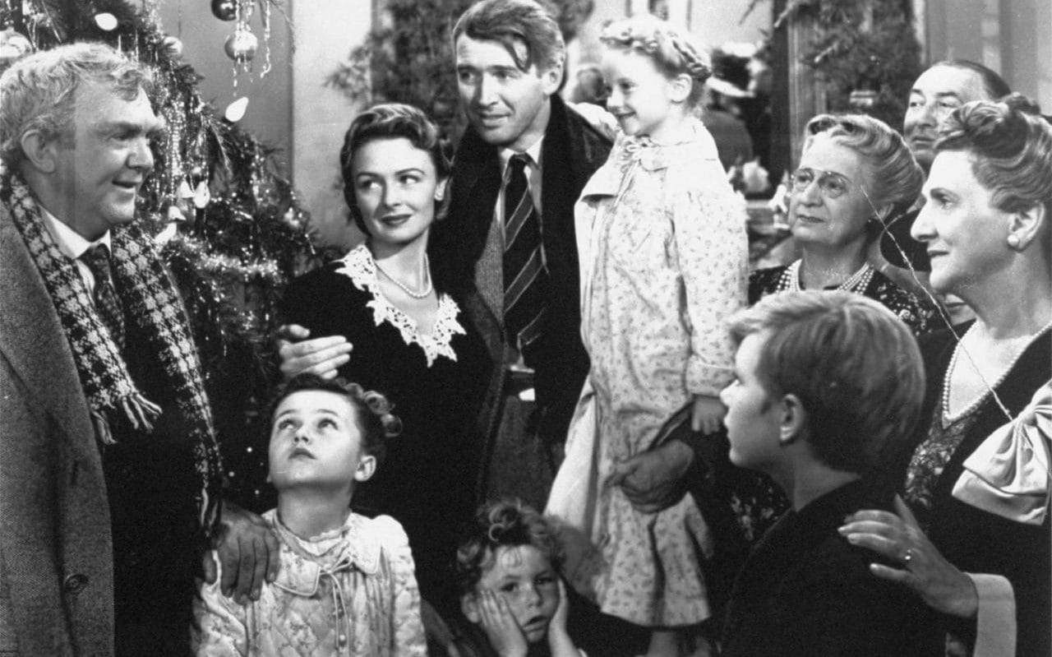
6.
IT’S A WONDERFUL LIFE

Slide 49
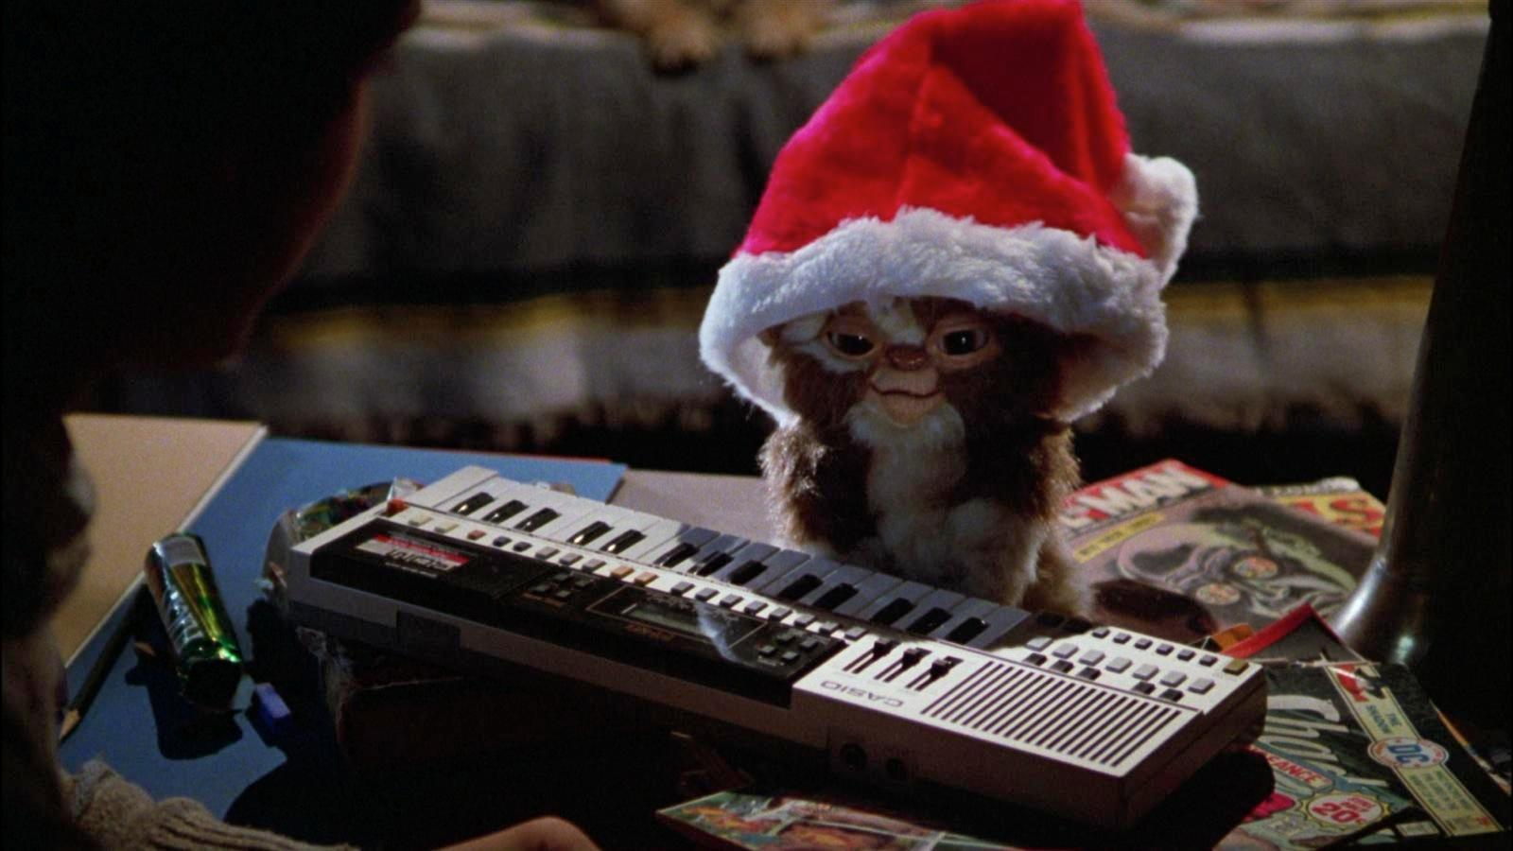
7.
GREMLINS

Slide 50
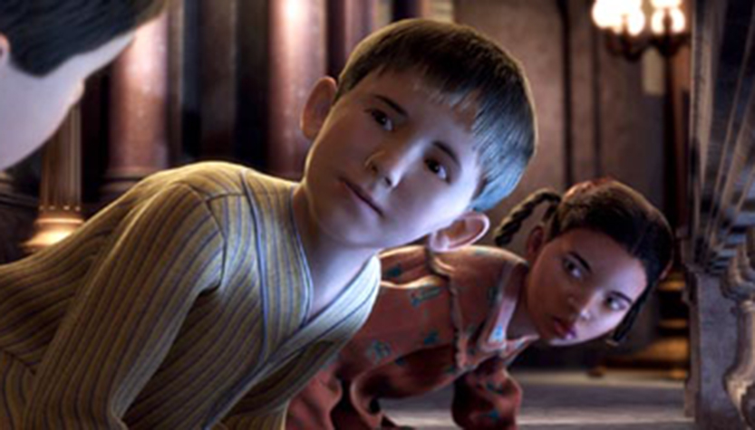
8.
POLAR EXPRESS

Slide 51
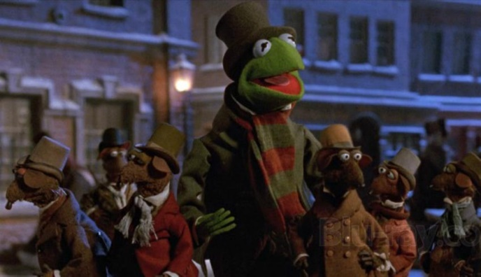
9.
THE MUPPET CHRISTMAS CAROL

Slide 52
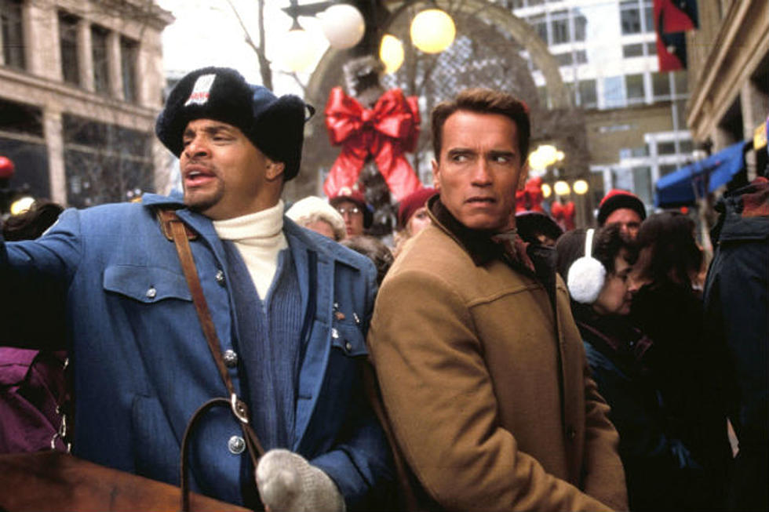
10.
JINGLE ALL THE WAY

Slide 53
Round 5 continued:
Famous Christmas movie quotes
THE ANSWERS

Slide 54
1.
"Christmas isn't just a day, it's a frame of mind"
MIRACLE ON 34TH STREET

Slide 55
2.
“Merry Christmas you filthy animal!”
HOME ALONE 1 OR 2

Slide 56
3.
“Every time a bell rings, an angel gets his wings.”
IT’S A WONDERFUL LIFE

Slide 57
4.
"The best way to spread Christmas cheer is singing loud for all to hear”
ELF

Slide 58
"Seeing is believing, but sometimes the most real things in the world are the things we can't see"
5.
THE POLAR EXPRESS

Slide 59
“There’s a certain magic that comes with the very first snow. For when the first snow is also a Christmas snow, well, something wonderful is bound to happen”
6.
FROSTY THE SNOWMAN

Slide 60
"What if Christmas, he thought, doesn't come from a store. What if Christmas, perhaps, means a little bit more."
7.
HOW THE GRINCH STOLE CHRISTMAS

Slide 61
8.
"You're skipping Christmas! Isn't that against the law?"
CHRISTMAS WITH THE KRANKS

Slide 62
“It was the afternoon of Christmas Eve and Scrooge was conscious of a thousand odors, each one connected with a thousand thoughts & hopes & joys & cares long, long forgotten”
9.
THE MUPPET CHRISTMAS CAROL

Slide 63
“We get one day a year to prove we're not screw-ups and what do we do? We screw it up.”
10.
JINGLE ALL THE WAY

Slide 64
Round 6:
Christmas Close Ups
Can you tell what these Christmas related things are in extreme close ups?

Slide 65
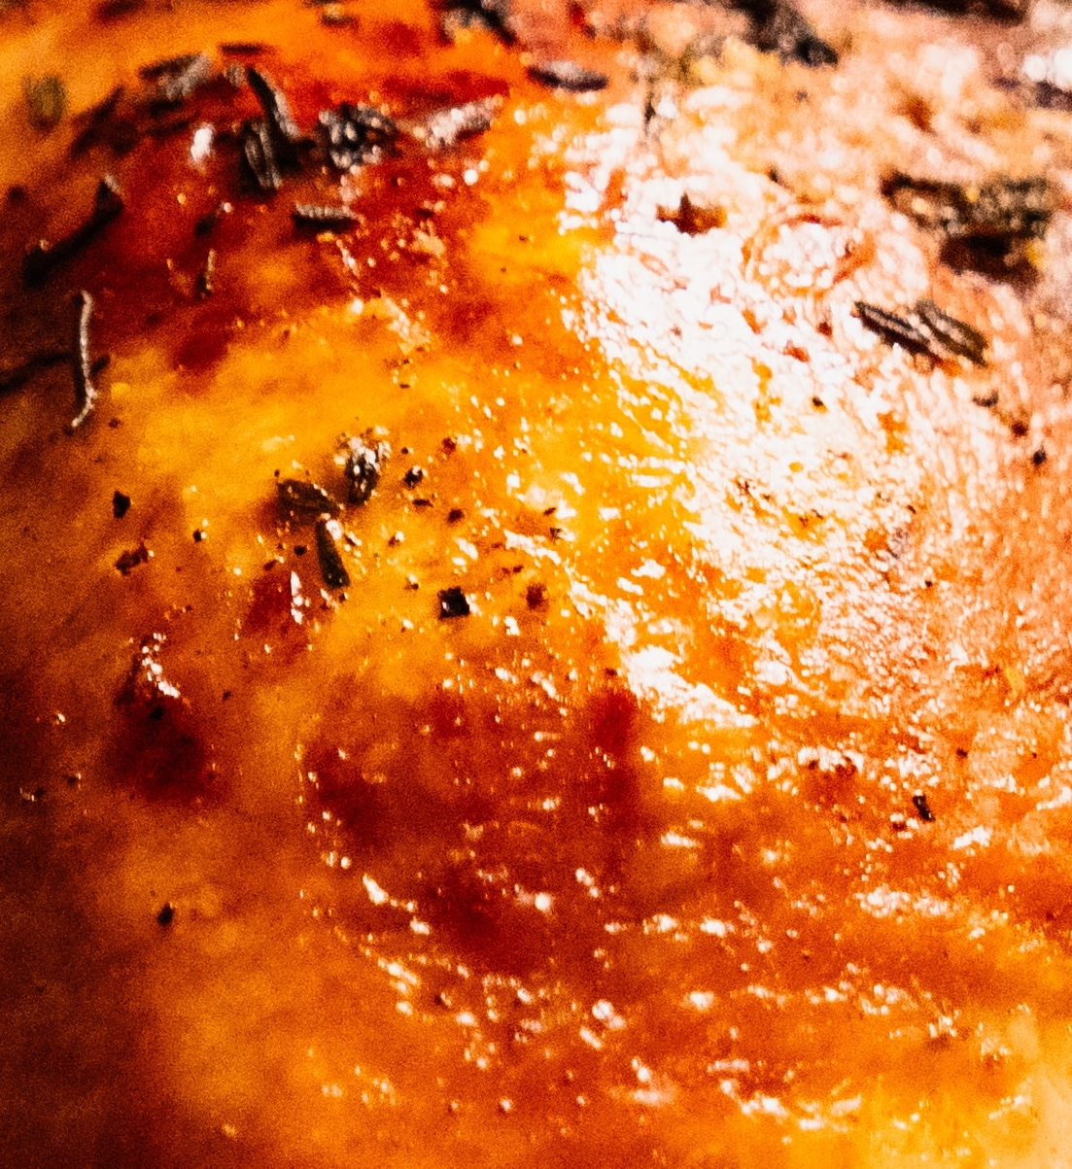
1.
10.

Slide 66
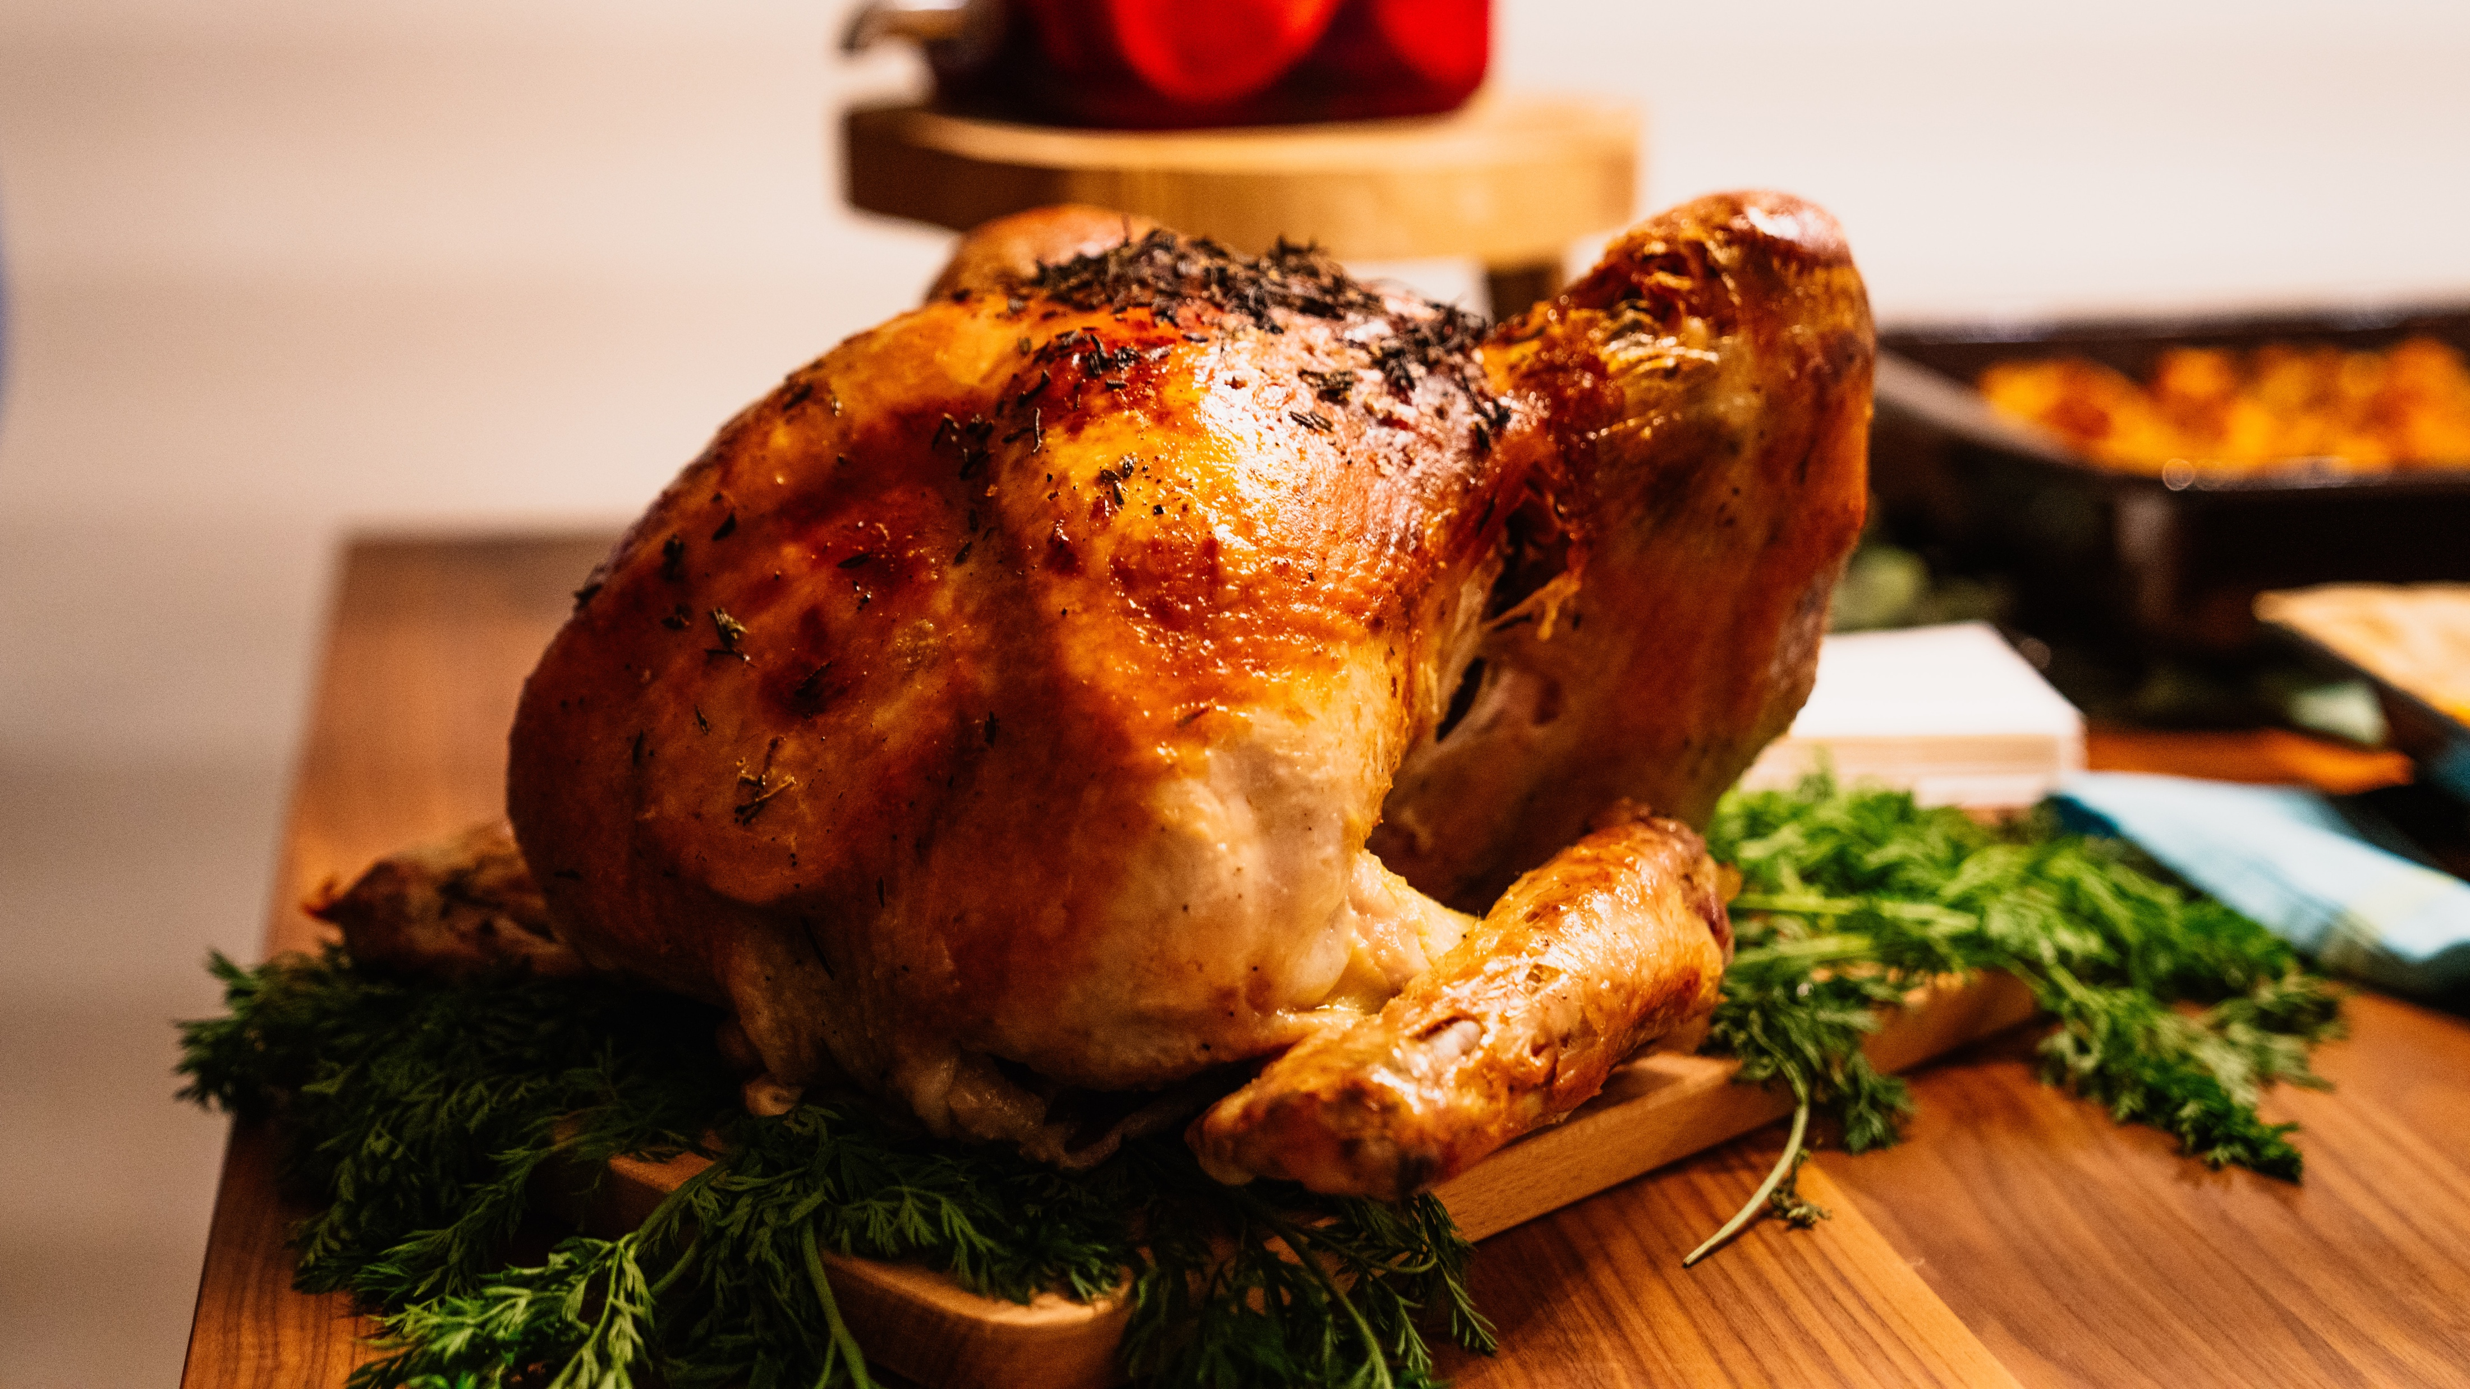
1.
10.

Slide 67
2.
10.

Slide 68
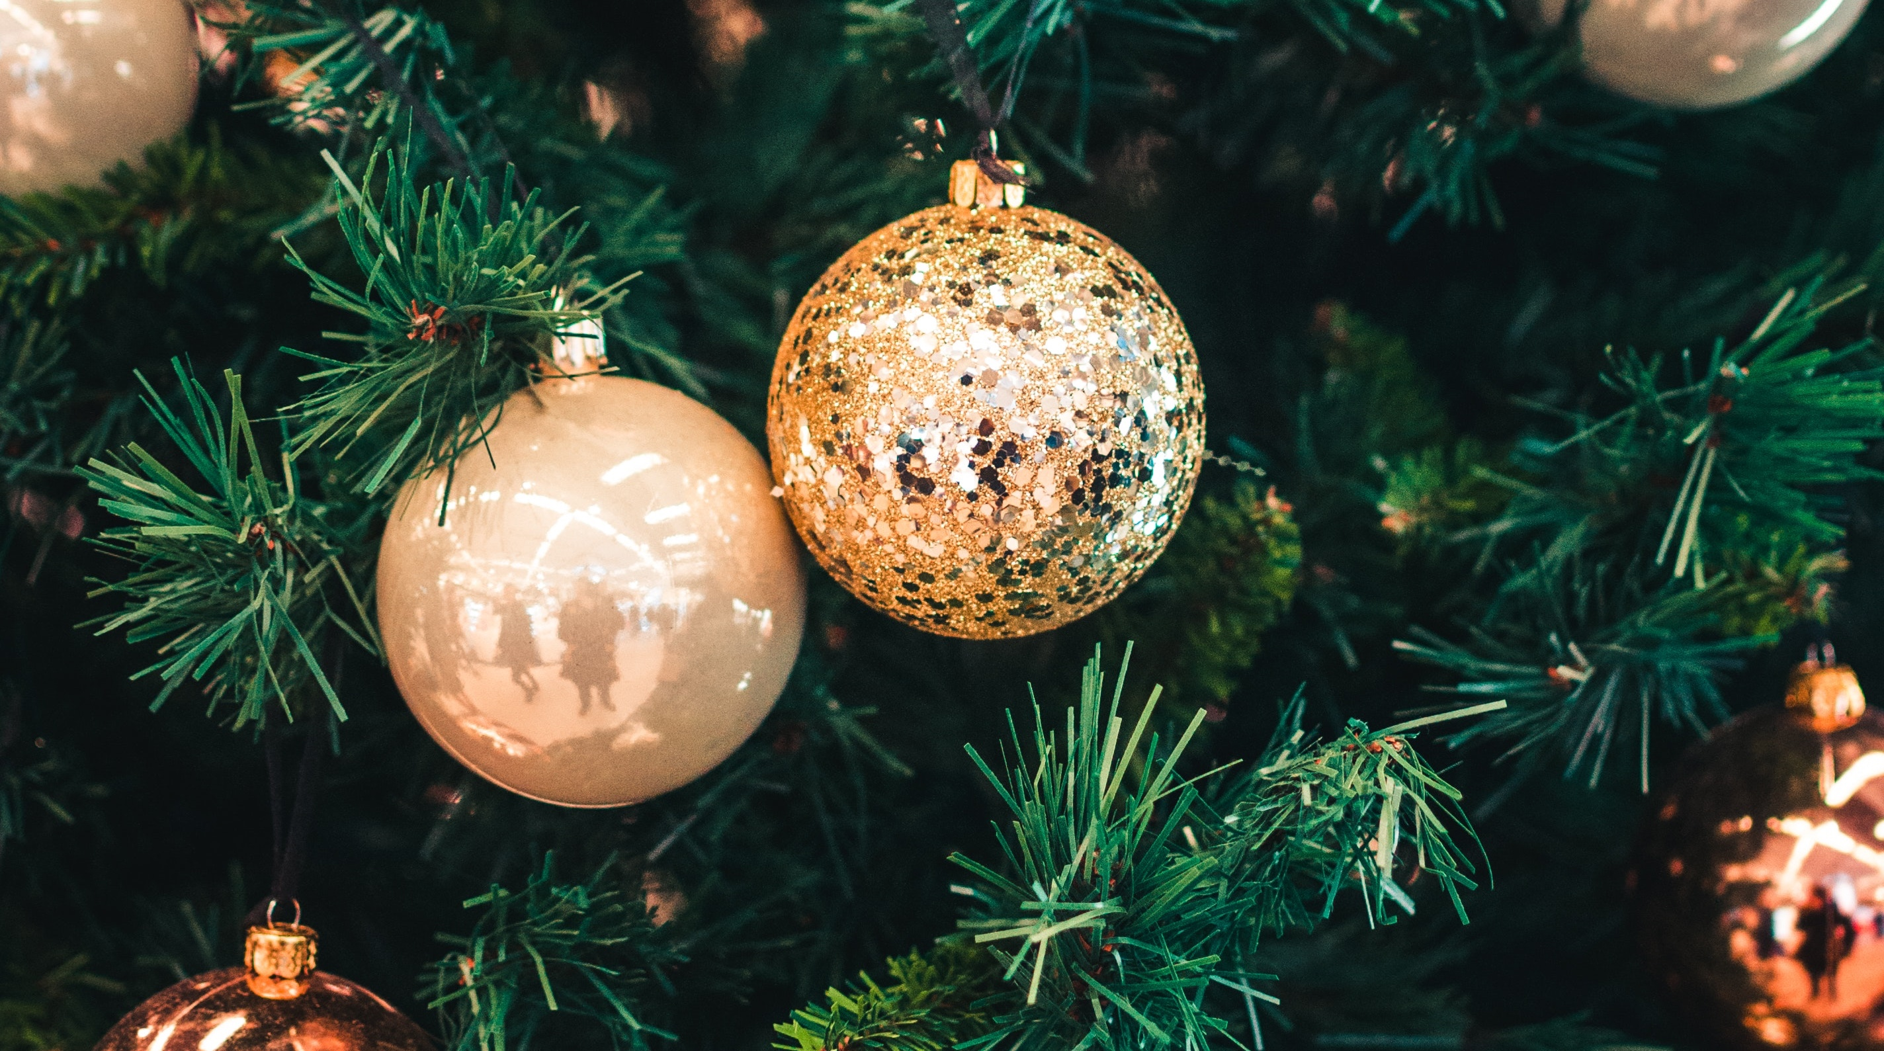
2.
10.

Slide 69
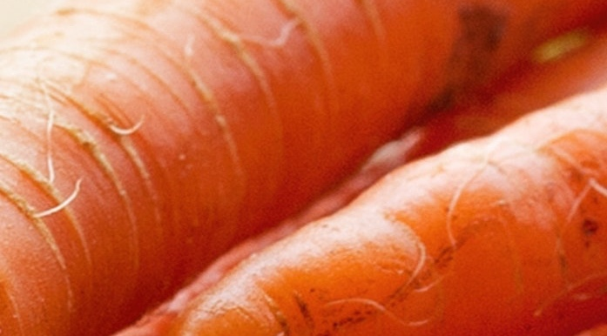
3.
10.

Slide 70
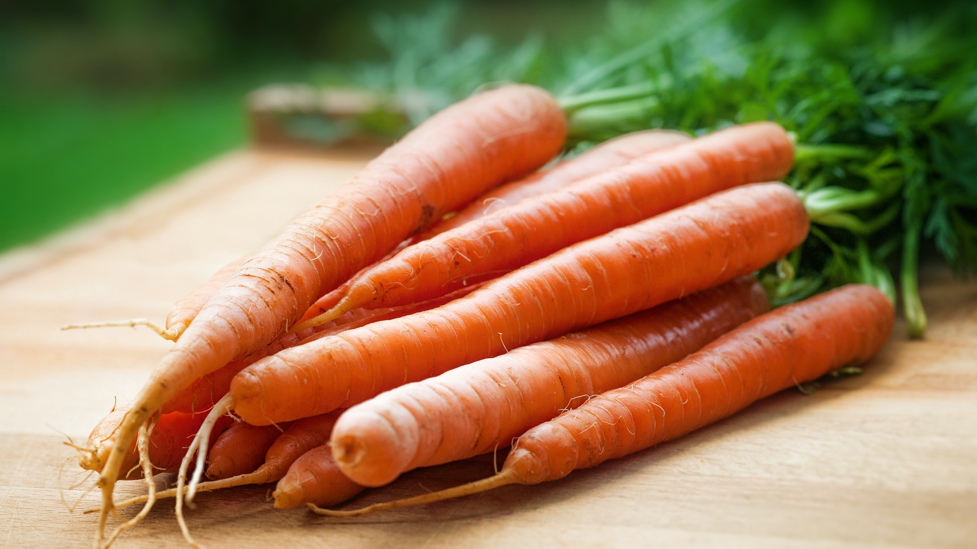
3.
10.

Slide 71
4.

Slide 72
4.

Slide 73
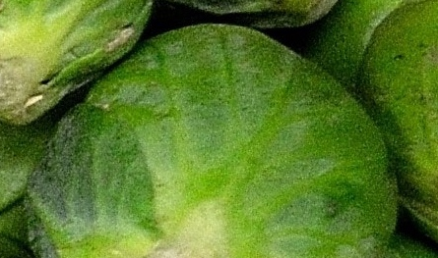
5.
10.

Slide 74
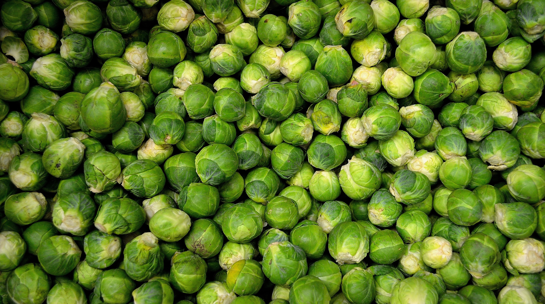
5.
10.

Slide 75
6.

Slide 76
6.

Slide 77
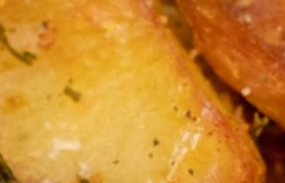
7.

Slide 78
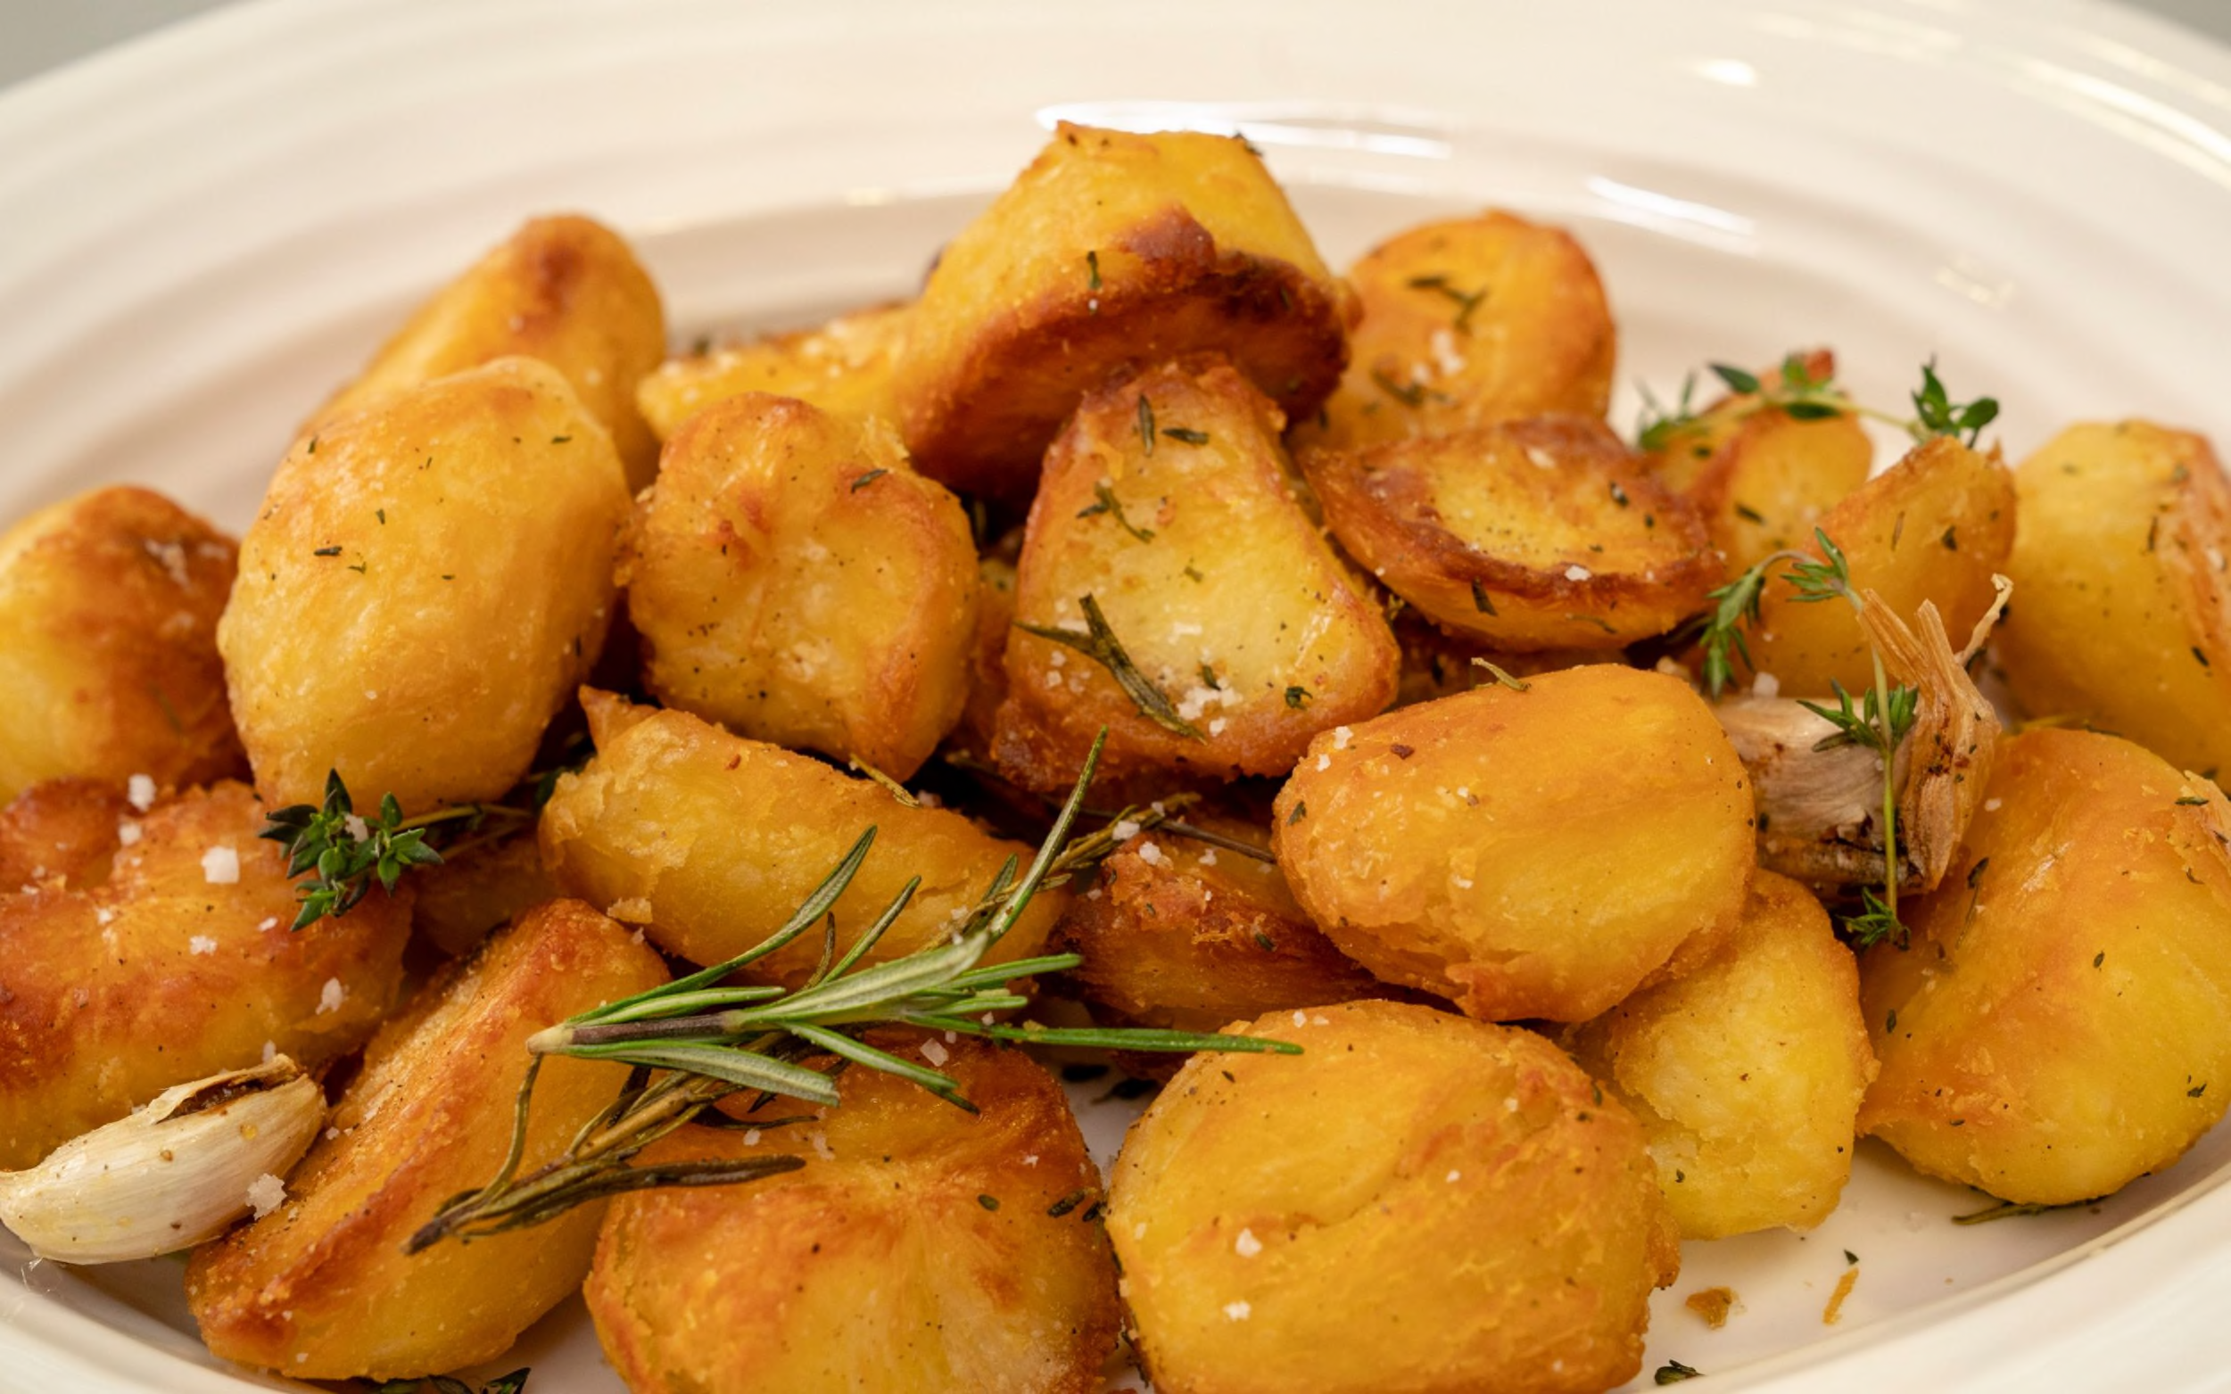
7.

Slide 79
8.

Slide 80
8.

Slide 81
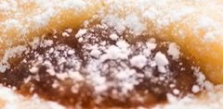
9.

Slide 82
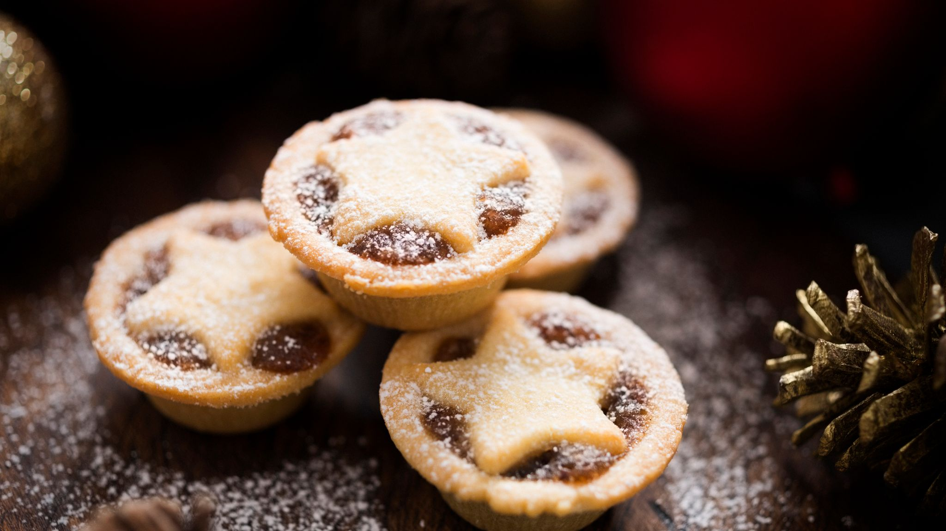
9.

Slide 83
10.

Slide 84
10.

Slide 85
Round 7:
True or false
THE ANSWERS

Slide 86
For a Christmas to be officially classified as “white” a single snowflake needs to be observed falling in the 24 hours of 25th December on the rooftop of the Met Office HQ in London
1.
TRUE

Slide 87
2.
The first ever SMS text message was 'Merry Christmas'
TRUE - The text was sent by engineer Neil Papworth to Richard Jarvis on December 3rd, 1992

Slide 88
3.
Norway is the leading exporter of Christmas trees
FALSE - Canada is the world's leading exporter of Christmas trees

Slide 89
4.
Reindeer lose their antlers every year
TRUE - Male reindeer usually lose their antlers shortly before the Christmas period. Females tend to lose theirs in the New Year

Slide 90
5.
In the UK, artificial Christmas trees outsell natural Christmas trees by a ratio of 3:1
FALSE – It’s actually the other way round

Slide 91
Round 8:
Christmas Music round
THE ANSWERS

Slide 92
1990 | Cliff Richard | Saviour’s Day
1991 | Queen | Bohemian Rhapsody/Those were the days of our lives
1992 | Whitney Houston | I will always love you
1993 | Mr Blobby | Mr Blobby
1994 | East 17 | Stay another day
1995 | Michael Jackson | Earth Song
1996 | Spice Girls | 2 become 1
1997 | Spice Girls | Too much
1998 | Spice Girls | Goodbye
1999 | Westlife | I have a dream/Seasons in the sun
2000 | Bob the Builder | Can we fix it?
2001 | Robbie Williams/Nicole Kidman | Somethin’ stupid
2002 | Girls Aloud | Sound of the Underground
2003 | Michael Andrews ft Gary Jules | Mad World
2004 | Band Aid 20 | Do they know it’s Christmas?

Slide 93
2005 | Shayne Ward | That’s my goal
2006 | Leona Lewis | A moment like this
2007 | Leon Jackson | When you believe
2008 | Alexandra Burke | Hallelujah
2009 | Rage against the machine | Killing in the name
2010 | Matt Cardle | When we collide
2011 | Military Wives | Wherever you are
2012 | Justice Collective | He ain’t heavy he’s my brother
2013 | Sam Bailey | Skyscraper
2014 | Ben Haenow | Something I need
2015 | Lewisham & Greenwich NHS Choir | A bridge over you
2016 | Clean Bandit Ft Sean Paul & Anne-Marie | Rockabye
2017 | Ed Sheeran | Perfect
2018 | Ladbaby | We built this city
2019 | Ladbaby | I love sausage rolls

Slide 94
Round 9:
The First Christmas
THE ANSWERS

Slide 95
Joseph was originally from... (Luke 2:3)
a) Bethlehem
b) Nazareth
c) Hebron
d) Jerusalem
e) None of the above
1.

Slide 96
What does the Bible say that the innkeeper said to Mary and Joseph? (Luke 2:7)
a) “There is no room in the inn.”
b) “I have a stable you can use.”
c) “Come back later and I should have some vacancies.”
d) Both A and B
e) None of the above
2.
Notes:
The innkeeper didn’t “say” anything (See Luke 2:7). The Bible doesn’t even mention an “innkeeper” because the “inn” was probably more like a guest room in a house.

Slide 97
Who saw the star in the east?
a) Shepherds
b) Mary and Joseph
c) Three kings
d) Both A and C
3.
Notes:
This is a “trick” question. The “magi” saw the star. However, the Bible doesn’t say how many there were and they were not kings, but astronomers.

Slide 98
What did the angels say/sing to the shepherds? (Luke 2:14)
a) “Glory to God in the highest, etc.”
b) “Alleluia”
c) “Unto us a child is born, unto us a son is given”
d) “Joy the world, the Lord is come”
e) “Glory to the newborn King”
4.

Slide 99
What is a heavenly host?
a) The angel at the gate of heaven
b) The angel who serves refreshments in heaven
c) An angel choir
d) An angel army
e) None of the above
5.

Slide 100
What is frankincense?
a) A precious metal
b) A precious fabric
c) A precious perfume
d) A spice used for burying people
e) None of the above
6.

Slide 101
How many wise men came to see Jesus?
a) 3
b) 6
c) 9
d) 12
e) We don’t know
7.

Slide 102
The wise men stopped in Jerusalem... (Matthew 2:2)
a) To inform Herod about Jesus
b) To find out where Jesus was
c) To ask about the star
d) To buy presents
e) None of the above
8.

Slide 103
Where did the wise men find Jesus? (Matthew 2:11)
a) In a stable
b) In Nazareth
c) In Saudi Arabia
d) In a house
e) In a temple
9.

Slide 104
In which books of the Bible do we find the Christmas story?
a) Matthew and Mark
b) Matthew and Luke
c) Matthew, Mark and Luke
d) Matthew, Mark, Luke and John
10.

Slide 105
Round 10:
Christmas Anagrams
Can you solve these Christmas anagrams?

Slide 106
TASAN | SANTA
LEF | ELF
ETSPNER | PRESENT
ESJUS | JESUS
NAELG | ANGEL
SATR | STAR
ROPULHD | RUDOLPH
AWNOMSN | SNOWMAN
GCSIONTK | STOCKING
CEDERBME | DECEMBER

